Slide 1
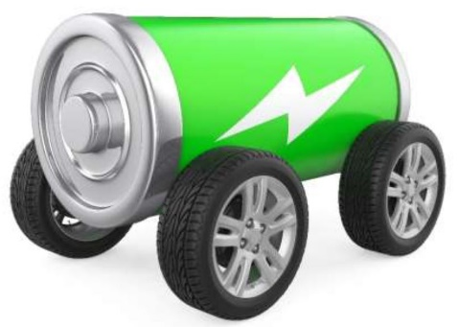
EV Challenge Construction
Slides courtesy of the Technology Student Association
www.tsaweb.org

Slide 5
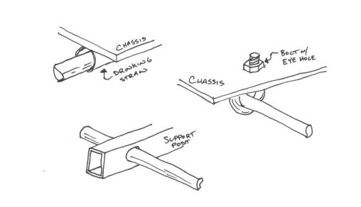
Bearings

Slide 7
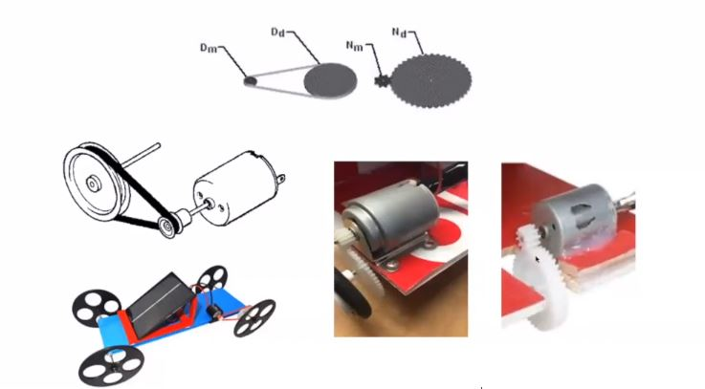
Gears

